Slide 1

SORTING, SELECTION AND SEQUENCING
By: Ashok Basnet

Slide 2
Outline
General method of problem solving: Divide and Conquer Method
Binary Search Technique
Finding the Minimum and Maximum
Merge Sort, Quick Sort and Selection Sort
Strassen's Matrix Multiplication
General method of problem solving: The Greedy Method
Knapsack Problem: Fractional Knapsack Problem
Tree Vertex Splitting
Job Sequencing with Deadlines
Minimum Cost Spanning Tree
Optimal Storage Allocation on Magnetic Tapes
Optimal Merge Patterns

Slide 3
Divide and Conquer Method
Recursion:
Divide and Conquer Method relies on recursion, where a problem is recursively broken down into smaller sub-problems.
Breaking Down the Problem:
The algorithm divides the problem into two or more sub-problems, often of the same or related type.
Solving Sub-Problems:
The sub-problems are solved independently, either directly if they are simple enough or by further breaking them down recursively.
Combining Solutions:
The solutions to the sub-problems are combined to produce a solution for the original problem.
Efficiency:
D&C often leads to efficient algorithms because it breaks down complex problems into simpler, manageable sub-problems.

Slide 4
Divide and Conquer Method
Applications: D&C is widely used in solving various types of problems, including:
Sorting Algorithms: such as Quick Sort and Merge Sort.
Multiplying Large Numbers: for efficient multiplication.
Closest Pair of Points: finding the closest pair in a set of points.
Discrete Fourier Transform (FFT): a fast algorithm for computing the DFT.
Example Algorithms:
Quick Sort: Sorts an array by partitioning and recursively sorting sub-arrays.
Merge Sort: Divides the array into two halves, recursively sorts them, and then merges them.

Slide 5
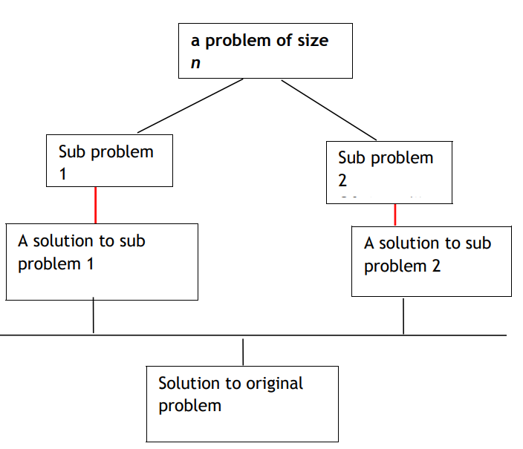
Divide and Conquer Method
Divide the problem into a number of sub problems
Conquer the sub problems by solving them recursively.
If the sub problem sizes are small enough, solve the sub problems recursively, and then combine these solutions to create a solution to the original problem.

Slide 6
Divide and Conquer Method
DANDC (P) {
if SMALL (P) then return S (p);
else
{
divide p into smaller instances p1, p2, …. Pk, k  1;
apply DANDC to each of these sub problems;
return (COMBINE (DANDC (p1) , DANDC (p2),…., DANDC (pk));
}
}
SMALL (P) is a Boolean valued function which determines whether the input size is small enough so that the answer can be computed without splitting.
If this is so function ‘S’ is invoked otherwise, the problem ‘p’ into smaller sub problems. These sub problems p1, p2, . . . , pk are solved by recursive application of DANDC.

Slide 7
Binary Search (Recursive and Iterative)
Binary search is a search algorithm used to find the position of a target value within a sorted array.
It is a highly efficient algorithm with a time complexity of O(log n), where n is the number of elements in the array.
The key idea behind binary search is to repeatedly divide the search interval in half.
Steps:
Initial Setup:
Start with the entire sorted array.
Define Search Interval:
Define a search interval, initially the entire array.
Compare with Midpoint:
Compute the midpoint of the interval.
Compare the target value with the value at the midpoint.

Slide 8
Binary Search (Recursive and Iterative)
Steps:
Adjust Search Interval:
If the target value is equal to the midpoint value, the search is successful, and the index is returned.
If the target value is less than the midpoint value, adjust the search interval to the lower half (discard the upper half).
If the target value is greater than the midpoint value, adjust the search interval to the upper half (discard the lower half).
Repeat:
Repeat steps 3-4 until the target value is found or the search interval becomes empty.
Result:
If the target value is found, return its index.
If the search interval becomes empty, the target value is not in the array, and -1 is typically returned.

Slide 9
Binary Search (Recursive)
function recursiveBinarySearch(arr, target, low, high):
if low <= high:
mid = (low + high) // 2
if arr[mid] == target:
return mid
elif arr[mid] < target:
return recursiveBinarySearch(arr, target, mid + 1, high)
else:
return recursiveBinarySearch(arr, target, low, mid - 1)
else:
return -1

Slide 10
Binary Search (Iterative)
function iterativeBinarySearch(arr, target):
low = 0
high = length(arr) - 1
while low <= high:
mid = (low + high) // 2
if arr[mid] == target:
return mid
elif arr[mid] < target:
low = mid + 1
else:
high = mid - 1
return -1

Slide 11
Selection sort
Selection Sort is a simple comparison-based sorting algorithm that divides the input list into two parts: a sorted portion and an unsorted portion.
The algorithm repeatedly selects the smallest (or largest, depending on the sorting order) element from the unsorted portion and swaps it with the first unsorted element. This process continues until the entire list is sorted.
Initialization: The entire list is considered unsorted initially.
Selection of the Smallest Element: Iterate through the unsorted portion of the list to find the smallest element.
Swap: Swap the smallest element found in step 2 with the first element in the unsorted portion.
Expansion of the Sorted Portion: Expand the sorted portion to include the element that was just swapped.
Repeat: Repeat steps 2-4 for the remaining unsorted portion of the list until the entire list is sorted.
Result: The list is now sorted.

Slide 12
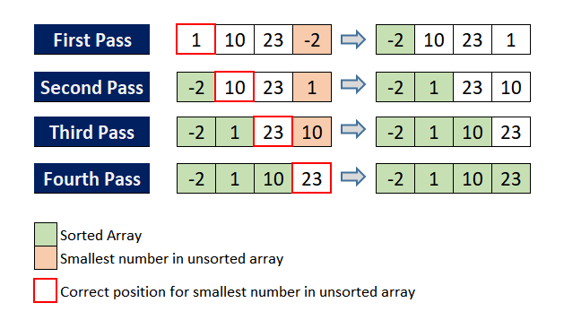
Selection sort

Slide 13
Selection sort - Iterative
function selectionSort(array, size):
repeat (size - 1) times:
set the first unsorted element as the minimum
for each of the unsorted elements:
if element < currentMinimum:
set element as new minimum
swap minimum with first unsorted position
end repeat
end function

Slide 14
Selection sort - Recursive
function recursiveSelectionSort(arr, start=0):
n = length(arr)
if start < n - 1:
min_index = start
for i from start + 1 to n - 1:
if arr[i] < arr[min_index]:
min_index = i
swap(arr[start], arr[min_index])
recursiveSelectionSort(arr, start + 1)
end function

Slide 15
Merge sort
Merge Sort is a divide-and-conquer sorting algorithm that works by dividing the unsorted list into n sublists, each containing one element (making them inherently sorted), and then repeatedly merging sublists to produce new sorted sublists until there is only one sublist remaining – the sorted list.
Here's a step-by-step overview of the Merge Sort algorithm:
Divide: Divide the unsorted list into n sublists, each containing one element. This is the base case of the recursion.
Conquer: Recursively sort each sublist.
Merge: Merge the sorted sublists to produce new sorted sublists until there is only one sublist remaining – the sorted list.
The key operation in Merge Sort is the merging step, where two sorted sublists are combined into a single sorted sublist. This process is repeated until the entire list is sorted.

Slide 16
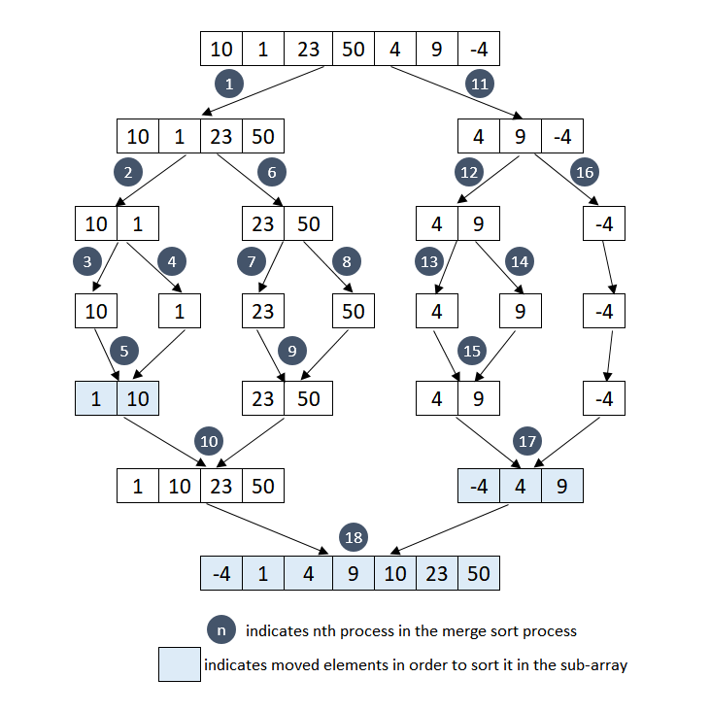
EXAMPLE

Slide 17
Merge sort
function merge_sort(arr):
if length(arr) > 1:
mid = length(arr) // 2
left_half = arr[0:mid]
right_half = arr[mid:]
merge_sort(left_half)
merge_sort(right_half)
merge(arr, left_half, right_half)

Slide 18
function merge(arr, left, right):
i = j = k = 0
while i < length(left) and j < length(right):
if left[i] < right[j]:
arr[k] = left[i]
i = i + 1
else:
arr[k] = right[j]
j = j + 1
k = k + 1
while i < length(left):
arr[k] = left[i]
i = i + 1
k = k + 1
while j < length(right):
arr[k] = right[j]
j = j + 1
k = k + 1

Slide 19
Quick sort
Quick Sort is a highly efficient and widely used sorting algorithm that falls under the category of divide-and-conquer algorithms.
The algorithm works by selecting a "pivot" element from the array and partitioning the other elements into two sub-arrays according to whether they are less than or greater than the pivot.
The sub-arrays are then recursively sorted.
Here's a high-level overview of the Quick Sort algorithm:
Partitioning:
Choose a pivot element from the array.
Partition the other elements into two sub-arrays: elements less than the pivot and elements greater than the pivot.
Recursion:
Recursively apply the Quick Sort algorithm to the two sub-arrays.
Combine:
The sorted sub-arrays are combined to produce the final sorted array.

Slide 20
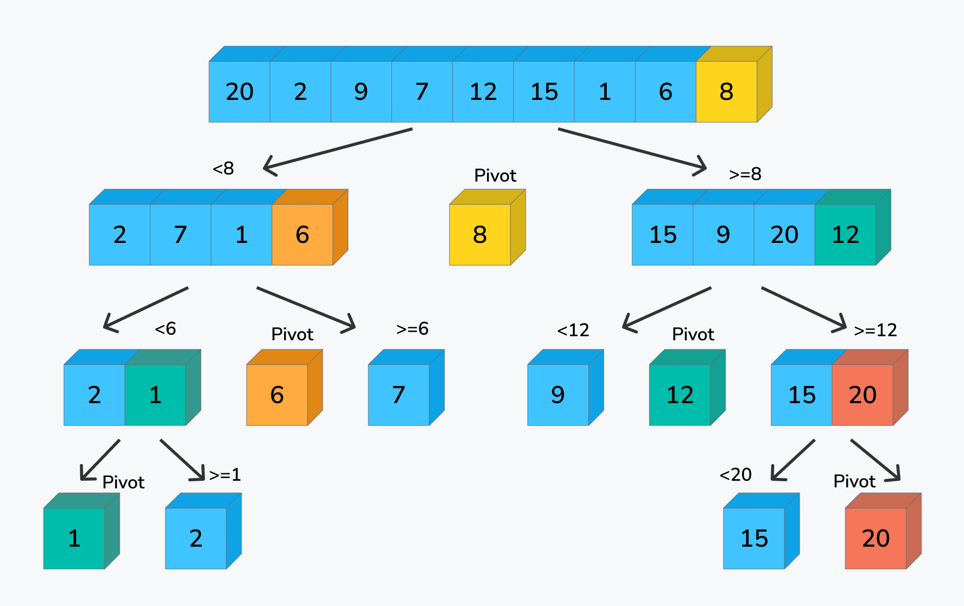
Quick sort

Slide 21
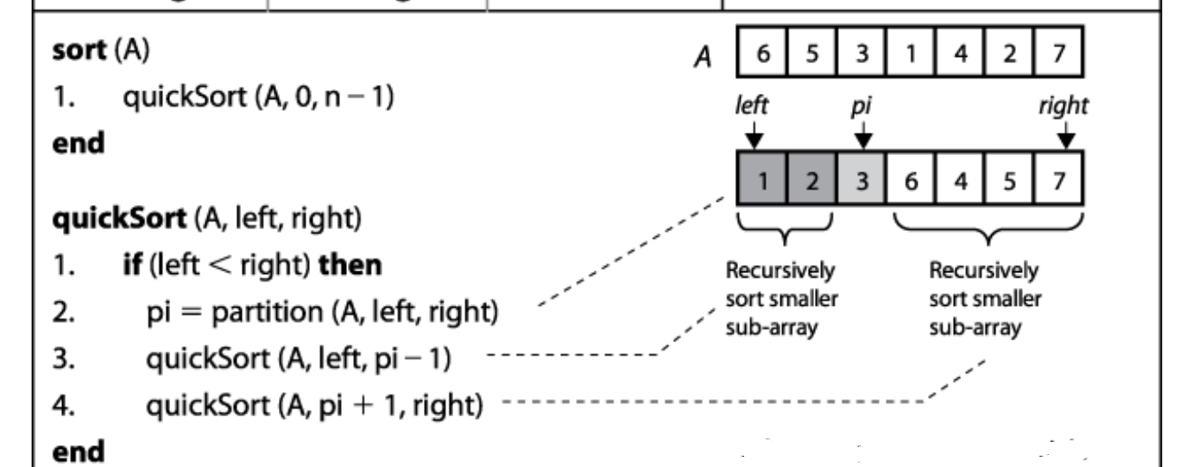

Slide 22
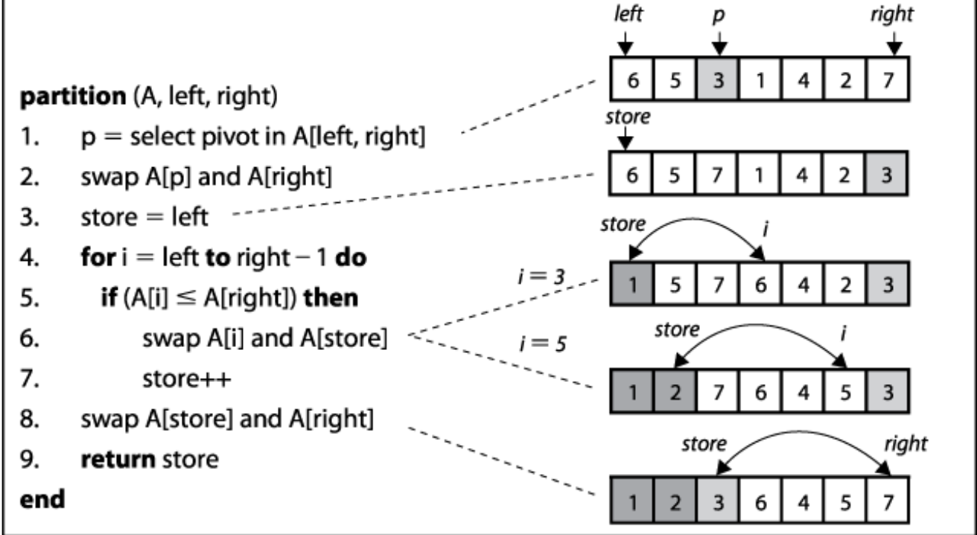

Slide 23
Selection Sort, Merge Sort, and Quick Sort
Selection Sort | Merge Sort | Quick Sort
Time Complexity: O(n^2) in the worst and average cases. In-Place: Yes. Stability: No. Use Cases: Small datasets, simple implementations, and situations where in-place sorting is crucial. | Time Complexity: O(n log n) in all cases (worst, average, and best). In-Place: No (requires additional space for merging). Stability: Yes. Use Cases: Large datasets, situations where stability is important, linked lists, and external sorting. | Time Complexity: O(n log n) in the average case, O(n^2) in the worst case (can be mitigated with randomization or careful pivot selection). In-Place: Yes (with the potential for log n recursion stack in the worst case). Stability: No. Use Cases: General-purpose sorting, large datasets, situations where average-case performance is crucial.

Slide 24
Selection Sort, Merge Sort, and Quick Sort
Time Complexity:
Quick Sort has an average-case time complexity of O(n log n), making it more efficient than Selection Sort for larger datasets. However, Quick Sort's worst-case time complexity is O(n^2), which can be a concern in certain situations.
Merge Sort consistently performs at O(n log n) in all cases, making it a reliable choice when a stable sort is needed.
Selection Sort consistently has a time complexity of O(n^2), making it less efficient for large datasets.
In-Place vs. Extra Space:
Selection Sort and Quick Sort are in-place algorithms, meaning they don't require additional memory proportional to the size of the input.
Merge Sort, on the other hand, requires additional space for merging, proportional to the size of the input. This can be a drawback in terms of space complexity.

Slide 25
Selection Sort, Merge Sort, and Quick Sort
Stability:
Quick Sort is not stable, meaning equal elements may not maintain their original order.
Selection Sort is not stable.
Merge Sort is stable.
Ease of Implementation:
Selection Sort is straightforward to implement.
Quick Sort involves partitioning and recursion and can be more challenging to implement correctly.
Merge Sort is relatively easy to implement but involves additional memory.

Slide 26
Finding the Maximum and Minimum
The Max-Min Problem in algorithm analysis is finding the maximum and minimum value in an array.
To find the maximum and minimum numbers in a given array numbers[ ] of size n, the following algorithm can be used.
naive method
divide and conquer approach.

Slide 27
Naïve Method
Naïve method is a basic method to solve any problem. In this method, the maximum and minimum number can be found separately.
Algorithm: Naive_Max_Min(numbers[ ])
Initialize max_value and min_value to the first element of the array
For each element num in numbers[1:]:
If num > max_value:
update max_value
If num < min_value:
update min_value
Return (max_value, min_value)
The number of comparison in Naive method is 2n - 2. The number of comparisons can be reduced using the divide and conquer approach.

Slide 28
Divide and Conquer Approach
Divide the array into two halves.
Recursively find the maximum and minimum values in each half.
Combine the results by taking the maximum of two maxima and the minimum of two minima.

Slide 29
Divide and Conquer Approach
DivideConquer_Max_Min(numbers, low, high):
If low == high:
return (numbers[low], numbers[low])
If high == low + 1:
compare numbers[low] and numbers[high] to determine max and min
Otherwise:
mid = (low + high) / 2
(max1, min1) = DivideConquer_Max_Min(numbers, low, mid)
(max2, min2) = DivideConquer_Max_Min(numbers, mid + 1, high)
Return (max(max1, max2), min(min1, min2))

Slide 30
STRASSEN'S MATRIX MULTIPLICATION

Slide 31
Strassen's Matrix Multiplication
Indeed, Strassen's Matrix Multiplication is a divide-and-conquer-based algorithm that aims to reduce the time complexity of matrix multiplication compared to the traditional cubic time complexity (O(n^3)).
The algorithm operates by dividing each input matrix into four smaller matrices and recursively multiplying these smaller matrices.
It involves seven recursive multiplications instead of the traditional eight.
The time complexity of Strassen's algorithm is approximately O(n^log2(7)), which is about O(n^2.81).
This improvement over the naive cubic time complexity is achieved through clever mathematical manipulations.

Slide 32
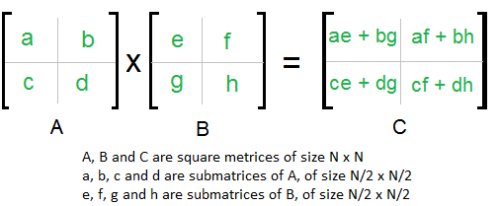
Strassen's Matrix Multiplication
For larger matrices this approach will continue until we recurse all the smaller sub matrices.
Suppose we have two matrices, A and B, and we want to multiply them to form a new matrix, C.
C=AB, where all A,B,C are square matrices. We will divide these larger matrices into smaller sub matrices n/2.

Slide 33
Strassen's Matrix Multiplication
Matrix Partitioning:
Given two matrices A and B, each of size n x n, divide them into four equal-sized submatrices. Let A be divided into A11, A12, A21, and A22, and B into B11, B12, B21, and B22.
Recursive Multiplication:
Recursively compute seven products using the smaller submatrices:
P1 = A11 * (B12 - B22)
P2 = (A11 + A12) * B22
P3 = (A21 + A22) * B11
P4 = A22 * (B21 - B11)
P5 = (A11 + A22) * (B11 + B22)
P6 = (A12 - A22) * (B21 + B22)
P7 = (A11 - A21) * (B11 + B12)

Slide 34
Strassen's Matrix Multiplication
Matrix Combinations:
Compute the four quadrants of the result matrix using these products:
C11 = P5 + P4 - P2 + P6
C12 = P1 + P2
C21 = P3 + P4
C22 = P5 + P1 - P3 - P7
Merge:
Combine the four quadrants to form the final result matrix C.

Slide 35
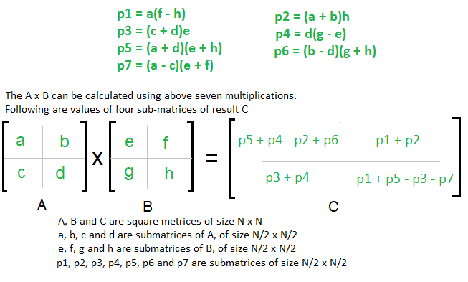
Strassen's Matrix Multiplication

Slide 36
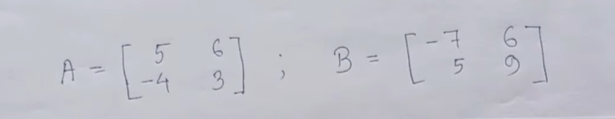
Strassen's Matrix Multiplication
Steps of Strassen’s matrix multiplication:
Divide the matrices A and B into smaller submatrices of the size n/2xn/2.
Using the formula of scalar additions and subtractions compute smaller matrices of size n/2.
Recursively compute the seven matrix products P_{i} = A_{i} B_{i} for i=1,2,…7.
Now compute the r,s,t,u submatrices by just adding the scalars obtained from above points.
In the above divide and conquer method, the main component for high time complexity is 8 recursive calls. The idea of Strassen’s method is to reduce the number of recursive calls to 7.
Exercise

Slide 37

RECURRENCE RELATION

Slide 38
Recurrence Relation
A recurrence relation is a mathematical expression that defines a sequence recursively in terms of one or more of its preceding terms. In other words, it is a way of defining the terms of a sequence based on the values of earlier terms in the sequence.
A general form of a recurrence relation for a sequence {a_n} is often written as:
a_{n} = f (a_{n−1} ,a_{n−2} ,…,a_{n−k} )
Here, a_{n} represents the n^{th} term in the sequence, and f is a function that relates the current term to one or more previous terms (up to k previous terms).
Recurrence relations are commonly used in various branches of mathematics, computer science, and other scientific fields to model and analyze processes that evolve over time in a step-by-step manner.
For example, the Fibonacci sequence is defined by the recurrence relation:
F (n) = F (n − 1) + F (n − 2)
with initial conditions F (0)=0 and F (1)=1. This recurrence relation defines each term in the Fibonacci sequence in terms of the two preceding terms.

Slide 39
Recurrence Relation
Let's consider a simple example of a recurrence relation. Suppose we have a sequence defined by the recurrence relation:
a_{n} = 2a_{n−1} + 3
with an initial condition a₀ =1.
Let's use this recurrence relation to find the first few terms of the sequence:
a₁ = 2a₀ +3= 2×1+3=5
a₂ = 2a₁ +3= 2×5+3=13
a₃ = 2a₂ +3= 2×13+3=29
This recurrence relation expresses each term a_{n} in terms of the previous term a_{n−1} and a constant term (3 in this case). Solving the recurrence relation means finding a closed-form expression for a_{n} in terms of n without referring to previous terms.
Depending on the specific recurrence relation, this process might involve techniques like substitution, characteristic equations, or other methods depending on the complexity of the relation.

Slide 40
Recurrence Relation
Linear Recurrence Relations:
The example provided earlier (a_{n} = 2a_{n−1} + 3) is a linear recurrence relation because each term is a linear combination of previous terms.
Linear recurrence relations are common and often have closed-form solutions.
Initial Conditions:
To fully specify a sequence defined by a recurrence relation, you typically need initial conditions. In the example, a₀ = 1 is an initial condition.
Degree of Recurrence:
The degree of a recurrence relation is determined by the highest power of the term a_{n} in the relation. In the linear example, the degree is 1.
Homogeneous and Non-homogeneous Recurrence Relations:
A homogeneous recurrence relation has no external terms (like constants) on the right-hand side of the equation. For example, a_{n} = 2a_{n−1} is homogeneous.
A non-homogeneous recurrence relation includes external terms. The previous example a_{n} = 2a_{n−1} + 3 is non-homogeneous.

Slide 41
Setting up a Recurrence Relation
Recurrence relations are used to reduce complicated problems to an iterative process based on simpler versions of the problem. An example problem in which this approach can be used is the Tower of Hanoi puzzle.
It's not immediately clear that a recursion solution will work for this problem. However, there are a couple things about this problem that make it a good candidate to solve with a recurrence relation.
Identifying a candidate problem to solve with a recurrence relation:
The problem can be reduced to simpler cases. The Tower of Hanoi puzzle can be simplified by removing some of the disks.
There is a numerical value, n, to identify each case. For the Tower of Hanoi puzzle, this numerical value is the number of disks.
The problem increases in complexity as the numerical identifier increases. As the number of disks in the Tower of Hanoi problem increases, it becomes more difficult to find a solution.
The goal for this exercise will be to develop a recurrence relation for T

Slide 42
Setting up a Recurrence Relation
Recurrence relations are used to reduce complicated problems to an iterative process based on simpler versions of the problem. An example problem in which this approach can be used is the Tower of Hanoi puzzle.
The Tower of Hanoi puzzle consists of three vertical pegs and several disks of various sizes. Each disk has a hole in its center for the pegs to go through.
The rules of the puzzle are as follows:
The puzzle begins with all disks placed on one of the pegs. They are placed in order of largest to smallest, bottom to top.
The goal of the puzzle is to move all of the disks onto another peg.
Only one disk may be moved at a time, and disks are always placed onto pegs.
Disks may only be moved onto an empty peg or onto a larger disk.
Let T_{n} be defined as the minimum number of moves needed to solve a puzzle with n disks.

Slide 43

Recurrence Relation
The most simple version of the Tower of Hanoi puzzle would contain only one disk.
In terms of the recurrence relation, n=1.
T₀ =1, because it would only take 1 move to move all the disks to another peg.

Slide 44
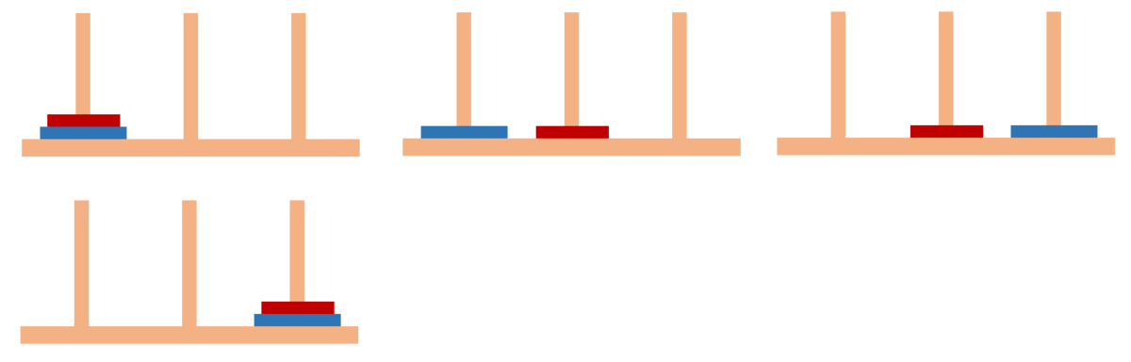
Recurrence Relation
Below is the solution to a Tower of Hanoi puzzle with n=2.
It can be seen from below that T₁ =3.

Slide 45
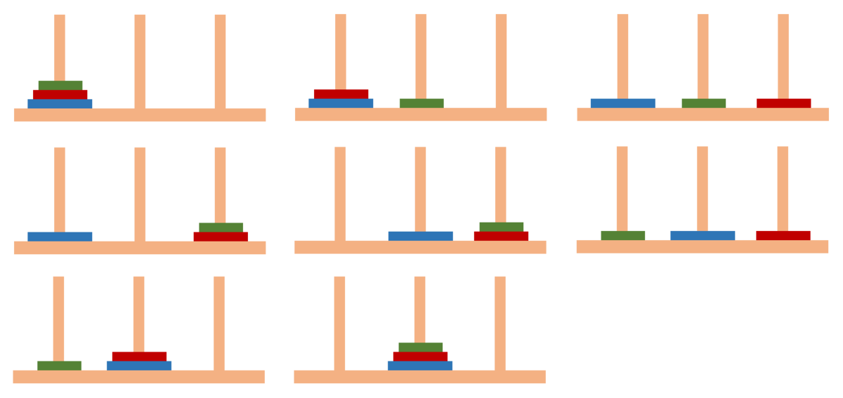
Recurrence Relation
Below is a solution to a Tower of Hanoi puzzle with n=3.
It can be seen from above that T₂ = 7.

Slide 46
Recurrence Relation
In terms of n,
Do T_{n−1} moves to get the smaller disks off the largest disk.
Do 1 move to move the largest disk.
Do T_{n−1} moves to get the smaller disks back onto the largest disk.
In total, the number of moves for n disks is
T_{n} = 2T_{n−1} +1

Slide 47
Recurrence Relation
#include <stdio.h>
void Test(int n) {
if (n > 0) {
printf("%d ", n); // Print the value
Test(n - 1); // Recursive call
}
}
int main() {
int n = 5; // You can change this to the desired value of n
Test(n);
return 0;
}

Slide 48
Preparing Recurrence Relation
void Test(int n) { // n
if (n > 0) {
printf("%d ", n); // 1
Test(n - 1); // n-1
}
}
So, T (n) = T (n-1) + 1
Hence, T (n) = 1 for n=0, and T (n-1) + 1 for n>0

Slide 49
Solving Recurrence Relation
Definition of Recurrence Relation: T (n) = T (n−1)+1
Initial Condition: T (n) = 1 for n = 0
Substituting and Simplifying:
T (n) = T (n−1) + 1
T (n−1) = T (n−2) + 1
Substitute T (n−1) into the first equation: T (n) = T (n−2) + 2
Continue substituting T (n−k) for k times: T (n) = T (n−k) + k
Assuming n-k=0: T (n) = T (0) + n = n + 1

Slide 50
Preparing Recurrence Relation
void Test(int n) {
if (n > 0) {
for (int i = 1; i < n; i = i + 1) {
printf("%d", n);
}
Test(n - 1);
}
}

Slide 51
Solving Recurrence Relation
So, T (n) = T (n-1) + n
Hence, T (n) = 1 for n=0, and T (n-1) + n for n>0
Solving above recurrence relation:
T (n) = T (n-1) + n
T (n-1) = T (n-2) + (n-1)
Substitute T (n-1), Hence T (n) = T (n-2) + (n-1) + n
T (n) = T (n-3) + (n-2) + (n-1) + n ….. continue for k times
Assume n-k=0, then n=k hence T(n) = 1 + 2 + 3 + ….... + n = n(n+1) / 2
Time complexity = O(n²)

Slide 52
Preparing Recurrence Relation
void Test(int n) {
if (n > 0) {
for (int i = 1; i < n; i = i * 2) {
printf("%d", n);
}
Test(n - 1);
}
}

Slide 53
Solving Recurrence Relation
So, T (n) = T (n-1) + log(n)
Hence, T (n) = 1 for n=0, and T (n-1) + log(n) for n>0
Solving above recurrence relation:
T (n) = T (n-1) + log(n)
T (n-1) = T (n-2) + log(n-1)
Substitute T (n-1), Hence T (n) = T (n-2) + log(n-1) + log(n)
T (n) = T (n-3) + log(n-2) + log(n-1) + log(n) ….. continue for k times
T (n) = T (n-k) + log1 + log2 + …... + log(n-1) + log(n)
Assume n-k=0, then n=k hence T (n) = T (0) + log(n!) = 1 + log(n!)
Time complexity = O(nlogn)

Slide 54
Recurrence Relation
Hence, from above relations:
T(n) = T(n-1) + 1 = O(n)
T(n) = T(n-1) + n = O(n²)
T(n) = T(n-1) + logn = O(nlogn)
T(n) = T(n-1) + n² = O(n³)

Slide 55
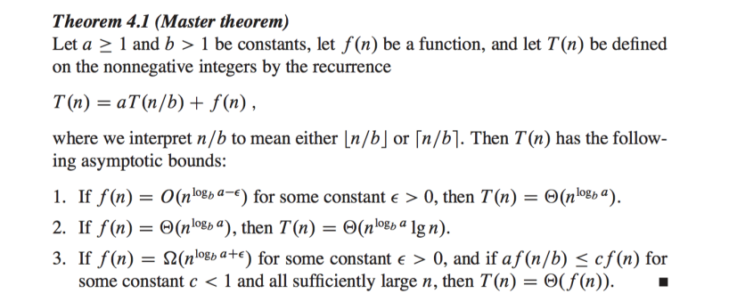
Master Theorem

Slide 56
Master Method for recurrence relation
In master method, the problem is divided into number of subproblems each of size n/b and need f(n) time to combine and or break the solution.
T(n) = aT(n/b) + f(n), where, n = size of input a = number of subproblems in the recursion n/b = size of each subproblem. All subproblems are assumed to have the same size. f(n) = cost of the work done outside the recursive call, which includes the cost of dividing the problem and cost of merging the solutions Here, a ≥ 1 and b > 1 are constants, and f(n) is an asymptotically positive function.

Slide 57
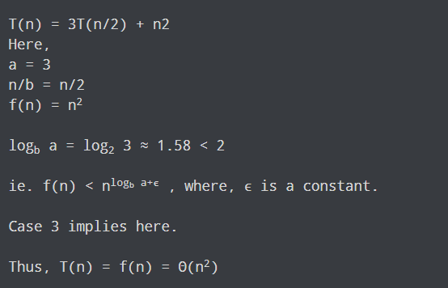
Example: Master Theorem

Slide 58
Example
Example-1: Binary Search – T(n) = T(n/2) + O(1) a = 1, b = 2, k = 0 and p = 0 b^{k} = 1. So, a = b^{k} and p > -1 [Case 2.(a)] T(n) = θ(n^{logba} log^{p+1}n) T(n) = θ(logn)
Example-2: Merge Sort – T(n) = 2T(n/2) + O(n) a = 2, b = 2, k = 1, p = 0 b^{k} = 2. So, a = b^{k} and p > -1 [Case 2.(a)] T(n) = θ(n^{logba} log^{p+1}n) T(n) = θ(nlogn)
Example-3: T(n) = 3T(n/2) + n² a = 3, b = 2, k = 2, p = 0 b^{k} = 4. So, a < b^{k} and p = 0 [Case 3.(a)] T(n) = θ(n^{k} log^{p}n) T(n) = θ(n²)

Slide 59
Example
Example-4: T(n) = 3T(n/2) + log²n a = 3, b = 2, k = 0, p = 2 b^{k} = 1. So, a > b^{k} [Case 1] T(n) = θ(n^{logba} ) T(n) = θ(n^{log23})
Example-5: T(n) = 2T(n/2) + nlog²n a = 2, b = 2, k = 1, p = 2 b^{k} = 2. So, a = b^{k} [Case 2.(a)] T(n) = θ(n^{logba}log^{p+1}n ) T(n) = θ(n^{log22}log³n) T(n) = θ(nlog³n)
Example-6: T(n) = 2^{n}T(n/2) + n^{n} This recurrence can’t be solved using above method since function is not of form T(n) = aT(n/b) + θ(n^{k} log^{p}n)

Slide 60
THE GREEDY METHOD

Slide 61
The Greedy Method
The greedy method is a simple strategy of progressively building up a solution, one element at a time, by choosing the best possible element at each stage.
At each stage, a decision is made regarding whether or not a particular input is in an optimal solution. This is done by considering the inputs in an order determined by some selection procedure.
If the inclusion of the next input, into the partially constructed optimal solution will result in an infeasible solution then this input is not added to the partial solution.
The selection procedure itself is based on some optimization measure. Several optimization measures are plausible for a given problem.
Most of them, however, will result in algorithms that generate sub-optimal solutions. This version of greedy technique is called subset paradigm.

Slide 62
The Greedy Method
Some problems like Knapsack, Job sequencing with deadlines and minimum cost spanning trees are based on subset paradigm.
For the problems that make decisions by considering the inputs in some order, each decision is made using an optimization criterion that can be computed using decisions already made.
This version of greedy method is ordering paradigm. Some problems like optimal storage on tapes, optimal merge patterns and single source shortest path are based on ordering paradigm.

Slide 63
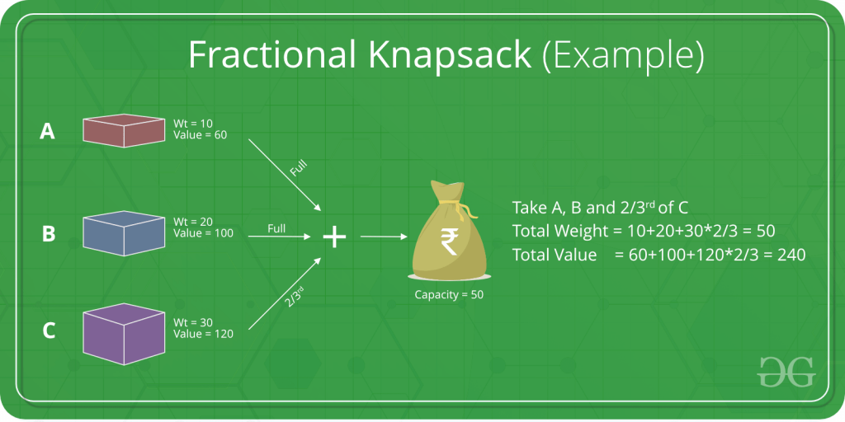
The Greedy Algorithm

Slide 64
The Greedy Algorithm
Greedy is an algorithmic paradigm that builds up a solution piece by piece, always choosing the next piece that offers the most obvious and immediate benefit.
So, the problems where choosing locally optimal also leads to global solution are the best fit for Greedy.
For example consider the Fractional Knapsack Problem. The local optimal strategy is to choose the item that has maximum value vs weight ratio.
This strategy also leads to a globally optimal solution because we are allowed to take fractions of an item.

Slide 65
Fractional Knapsack Problem
Given the weights and values of N items, in the form of {value, weight} put these items in a knapsack of capacity W to get the maximum total value in the knapsack.
In Fractional Knapsack, we can break items for maximizing the total value of the knapsack.
In the 0-1 Knapsack problem, we are not allowed to break items. We either take the whole item or don’t take it.
Input: arr[] = {{60, 10}, {100, 20}, {120, 30}}, W = 50
Output: 240
Explanation: By taking items of weight 10 and 20 kg and 2/3 fraction of 30 kg.
Hence total price will be 60 + 100 + (2/3) (120) = 240
Input: arr[] = {{500, 30}}, W = 10
Output: 166.667

Slide 66
Fractional Knapsack Problem
The basic idea of the greedy approach is to calculate the ratio value/weight for each item and sort the item on the basis of this ratio.
Then take the item with the highest ratio and add them until we can’t add the next item as a whole and at the end add the next item as much as we can. Which will always be the optimal solution to this problem. It uses following steps:
Calculate the ratio(value/weight) for each item.
sort all the items in decreasing order of the ratio.
initialize result =0, current_capacity = given_capacity.
do the following for every item “i” in the sorted order:
If the weight of the current item is less than or equal to the remaining capacity then add the value of that item into the result
Else add the current item as much as we can and break out of the loop.
return result.

Slide 67
Knapsack Problem
Say we have knapsack of capacity(m) = 20
1. Greedy about profit : Obj1 have max profit. Now Remaining weight: 2kg. Now obj2 can only be included 2/15 of obj2. So overall profit = 25 + 24*2/15 = 28.2
2. Greedy about weight: Here we put least profitable object. Minimum weight object is obj3, we put it in the bag. Then 10/15 of the obj2 is added.
So overall profit: 15 + 24*2/3 = 31
Objects | Obj1 | Obj2 | Obj3
Profit | 25 | 24 | 15
Weight | 18 | 15 | 10

Slide 68
Knapsack Problem
Say we have knapsack of capacity(m) = 20
But we are not getting optimal solution from the previous method.
So compute profit/weight
So highest proportion is of object 2. We put obj2 in knapsack.
Remaining capacity: 20-15 = 5kg
Then we select 5/10th of obj3. So, remaining capacity: 0kg
Profit = 24 + 15 * ½ = 24+7.5 = 31.5
Objects | Obj1 | Obj2 | Obj3
Profit | 25 | 24 | 15
Weight | 18 | 15 | 10
p/w | 1.3 | 1.6 | 1.5

Slide 69
Knapsack Problem Algorithm
Knapsack Problem: Algorithm
for i=1 to n:
calculate profit / weight ratio
Sort objects in decreasing order of profit / weight ratio
for i=1 to n:
If m > 0 and w_{i} <= m
m = m - w_{i}
p = p + p_{i}
else break,
if(m > 0)
p = p + p_{i} (m / w_{i})

Slide 70
Input: n: Number of items, weights[]: Array of item weights, profits[]: Array of item profits, m: Knapsack capacity
1. Create an array ratio[] to store profit/weight ratios for each item.
2. For i = 1 to n:
a. Calculate profit/weight ratio for each item: ratio[i] = profits[i] / weights[i].
3. Sort objects in decreasing order of profit/weight ratio.
4. Initialize variables:
- totalProfit = 0, remainingCapacity = m
5. For i = 1 to n:
a. If remainingCapacity > 0 and weights[i] <= remainingCapacity:
- Include the entire item in the knapsack.
- remainingCapacity - = weights[i]
- totalProfit += profits[i]
b. Otherwise, break out of the loop.
6. If remainingCapacity > 0:
- Include a fraction of the next item to fill the remaining capacity.
- totalProfit += (remainingCapacity / weights[i]) * profits[i]
7. Output totalProfit as the maximum achievable profit.

Slide 71
Knapsack Problem
Object(O) | 1 | 2 | 3 | 4 | 5 | 6 | 7
Profits(P) | 10 | 5 | 15 | 7 | 6 | 18 | 3
Weights(w) | 2 | 3 | 5 | 7 | 1 | 4 | 1
There are n=7 items
Capacity, m = 15 kg
So, problem is container loading problem

Slide 72
Knapsack Problem
Object(O) | 1 | 2 | 3 | 4 | 5 | 6 | 7
Profits(P) | 10 | 5 | 15 | 7 | 6 | 18 | 3
Weights(w) | 2 | 3 | 5 | 7 | 1 | 4 | 2
There are n=7 items
Capacity, m = 15 kg
So, problem is container loading problem
P/w | 5 | 1.6 | 3 | 1 | 6 | 4.5 | 3
X | Second: 1 |  |  |  | First: 1
 | x1 | x2 | x3 | x4 | x5 | x6 | x7
15-1 = 14kg
14-2 = 12kg and so on

Slide 73
Knapsack Problem
Object(O) | 1 | 2 | 3 | 4 | 5 | 6 | 7
Profits(P) | 10 | 5 | 15 | 7 | 6 | 18 | 3
Weights(w) | 2 | 3 | 5 | 7 | 1 | 4 | 2
P/w | 5 | 1.6 | 3 | 1 | 6 | 4.5 | 3
X | Second: 1 | 2/3 | 1 | 0 | First: 1 | 1 | 1
 | x1 | x2 | x3 | x4 | x5 | x6 | x7
15-1 = 14kg
14-2 = 12kg
12-4 = 8kg
8-5 = 3kg
3-1 = 2kg
2-2 = 0

Slide 74
Knapsack Problem
Object(O) | 1 | 2 | 3 | 4 | 5 | 6 | 7
Profits(P) | 10 | 5 | 15 | 7 | 6 | 18 | 3
Weights(w) | 2 | 3 | 5 | 7 | 1 | 4 | 2
P/w | 5 | 1.3 | 3 | 1 | 6 | 4.5 | 3
X | Second: 1 | 2/3 | 1 | 0 | First: 1 | 1 | 1
 | x1 | x2 | x3 | x4 | x5 | x6 | x7
Compute sum(x_{i}w_{i})
Profit sum(x_{i}p_{i})
Constraint Sum(x_{i}w_{i}) <= m
Objective Sum(x_{i}p_{i}) needs to be maximum
Hence constraint needs to be fulfilled having maximized objective function.
Code Implementation

Slide 75
Job Sequencing with deadlines
When we are given a set of ‘n’ jobs. Associated with each Job i, deadline d_{i} >= 0 and profit P_{i} >= 0.
For any job ‘i’ the profit p_{i} is earned iff the job is completed by its deadline.
Only one machine is available for processing jobs. An optimal solution is the feasible solution with maximum profit.
Sort the jobs in ‘j’ ordered by their deadlines. The array d [1 : n] is used to store the deadlines of the order of their p-values.
The set of jobs j [1 : k] such that j [r], 1 ≤ r ≤ k are the jobs in ‘j’ and d (j [1]) ≤ d (j[2]) ≤ . . . ≤ d (j[k]).

Slide 76
Job Sequencing with deadlines
There are n jobs to be processed on a machine.
Each job i has a deadline d_{i} ≥ 0 and profit p_{i} ≥ 0 .
P_{i} is earned iff the job is completed by its deadline.
The job is completed if it is processed on a machine for unit time.
Only one machine is available for processing jobs.
Only one job is processed at a time on the machine.
A feasible solution is a subset of jobs J such that each job is completed by its deadline.
An optimal solution is a feasible solution with maximum profit value.

Slide 77
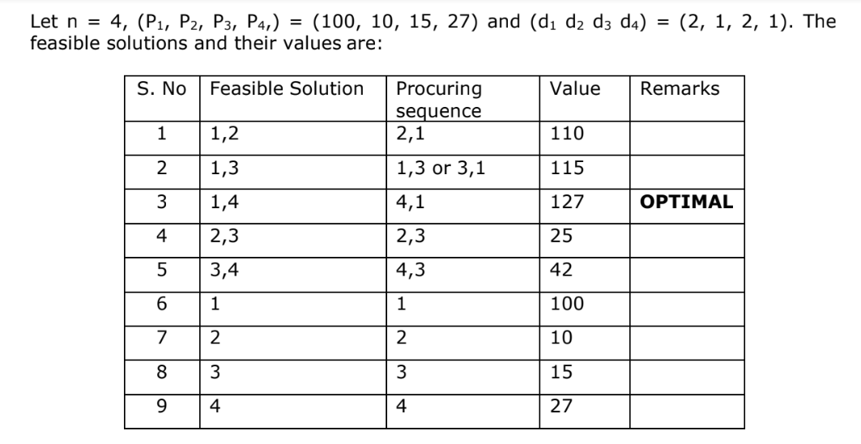
Job Sequencing with deadlines

Slide 78
Using Greedy Method
Step-01:
Sort all the given jobs in decreasing order of their profit.
Step-02:
Check the value of maximum deadline.
Draw a Gantt chart where maximum time on Gantt chart is the value of maximum deadline.
Step-03:
Pick up the jobs one by one.
Put the job on Gantt chart as far as possible from 0 ensuring that the job gets completed before its deadline.

Slide 79
Using Greedy Method
Jobs | J1 | J2 | J3 | J4 | J5 | J6
Deadlines | 5 | 3 | 3 | 2 | 4 | 2
Profits | 200 | 180 | 190 | 300 | 120 | 100
Write the optimal schedule that gives maximum profit.
Are all the jobs completed in the optimal schedule?
What is the maximum earned profit?

Slide 80
Using Greedy Method
Jobs | J4 | J1 | J3 | J2 | J5 | J6
Deadlines | 2 | 5 | 3 | 3 | 4 | 2
Profits | 300 | 200 | 190 | 180 | 120 | 100
Step-01: Sort all the given jobs in decreasing order of their profit.
Step-02: Value of maximum deadline: 5. So, draw a Gantt chart with maximum time on Gantt chart = 5.
We take each job one by one in the order they appear in Step-01.
We place the job on Gantt chart as far as possible from 0.
We take job J4. Since its deadline is 2, so we place it in the first empty cell before deadline 2.
We take job J1. Since its deadline is 5, so we place it in the first empty cell before deadline 5.
We take job J3. Since its deadline is 3, so we place it in the first empty cell before deadline 3.
We take job J2. Since its deadline is 3, so we place it in the first empty cell before deadline 3.
Now, we take job J5. Since its deadline is 4, so we place it in the first empty cell before deadline 4.
The only job left is job J6 whose deadline is 2. All the slots before deadline 2 are already occupied. Thus, job J6 can not be completed.

Slide 81
Using Greedy Method
Job Considered | Slot Assigned | Solution | Profit
-------- | ------- | --------- | 0
J1 | [4, 5] | J1 | 200
J2 | [0, 1], [4, 5] | J2, J1 | 380
J3 | [0, 1], [2, 3], , [4, 5] | J2, J3, J1 | 570
J4 | [0, 1], [1, 2], [2, 3], [4, 5] | J2, J4, J3, J1 | 870
J5 | [0, 1], [1, 2], [2, 3], [3, 4], [4, 5] | J2, J4, J3, J5, J1 | 990
J6 | ------- | ------- | ----------

Slide 82
Using Greedy Method
Summary:
The optimal schedule is: J2 , J4 , J3 , J5 , J1
This is the required order in which the jobs must be completed in order to obtain the maximum profit.
All the jobs are not completed in optimal schedule.
This is because job J6 could not be completed within its deadline.
Maximum earned profit
Sum of profit of all the jobs in optimal schedule
Profit of job J2 + Profit of job J4 + Profit of job J3 + Profit of job J5 + Profit of job J1
180 + 300 + 190 + 120 + 200 = 990 units

Slide 83
Exercise
Jobs | J1 | J2 | J3 | J4 | J5
Deadlines | 2 | 1 | 3 | 2 | 1
Profits | 60 | 100 | 20 | 40 | 20
Jobs | J1 | J2 | J3 | J4 | J5
Profits | 20 | 15 | 10 | 5 | 1
Deadlines | 2 | 2 | 1 | 3 | 3

Slide 84
Optimal Merge Patterns
Let's say we want merge two array:
Here we can compare elements from two array and place in the new array.
Time taken to merge these items is the sum of number of elements in each list.
Say we have 5 array with multiple elements to be merged, then we need optimal way to merge them.
A | B
3 | 5
8 | 9
12 | 11
20 | 16

Slide 85
Optimal Merge Patterns
Given n number of sorted files, the task is to find the minimum computations done to reach the Optimal Merge Pattern.
When two or more sorted files are to be merged altogether to form a single file, the minimum computations are done to reach this file are known as Optimal Merge Pattern.
If more than 2 files need to be merged then it can be done in pairs. For example, if need to merge 4 files A, B, C, D. First Merge A with B to get X1, merge X1 with C to get X2, merge X2 with D to get X3 as the output file.
If we have two files of sizes m and n, the total computation time will be m+n. Here, we use the greedy strategy by merging the two smallest size files among all the files present.
Examples: Given 3 files with sizes 2, 3, 4 units. Find an optimal way to combine these files

Slide 86
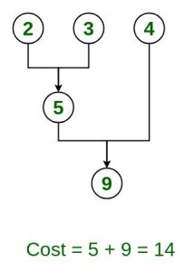
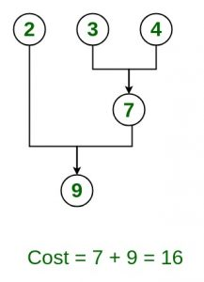

Optimal Merge Patterns

Slide 87
Optimal Merge Patterns
Given ‘n’ sorted files, there are many ways to pair wise merge them into a single sorted file.
As, different pairings require different amounts of computing time, we want to determine an optimal (i.e., one requiring the fewest comparisons) way to pair wise merge ‘n’ sorted files together.
This type of merging is called as 2-way merge patterns.
To merge an n-record file and an m-record file requires possibly n + m record moves, the obvious choice is, at each step merge the two smallest files together.
The two-way merge patterns can be represented by binary merge trees.

Slide 88
Optimal Merge Patterns
Solve:
Given five files (X1, X2, X3, X4, X5) with sizes (20, 30, 10, 5, 30). Apply greedy rule to find optimal way of pair wise merging to give an optimal solution using binary merge tree representation.

Slide 89
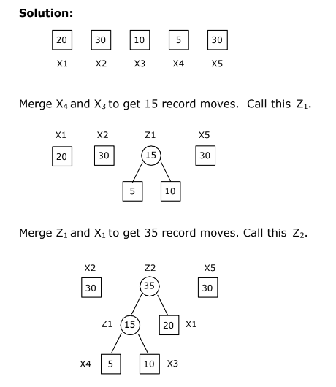

Slide 90
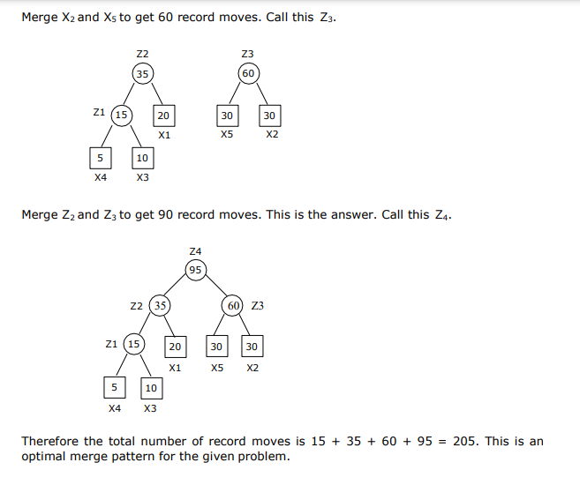

Slide 91
Optimal Merge Patterns
Solve:
Consider the sequence {3, 5, 9, 11, 16, 18, 20}. Find optimal merge patter for this data

Slide 92
Optimal Merge Patterns
Algorithm: TREE (n) for i := 1 to n – 1 do declare new node node.leftchild := least (list) // function returns minimum element from tree and delete it. node.rightchild := least (list) node.weight) := ((node.leftchild).weight) + ((node.rightchild).weight) insert (list, node); return least (list);

Slide 93
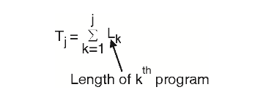
Optimal Storage Allocation on Magnetic Tapes
Given n programs P₁, P₂, …, P_{n} of length L₁, L₂, …, L_{n} respectively, store them on a tape of length L such that Mean Retrieval Time (MRT) is a minimum.
The retrieval time of the j^{th} program is a summation of the length of first j programs on tape.
Let T_{j} be the time to retrieve program P_{j}. The retrieval time of P_{j} is computed as,

Slide 94
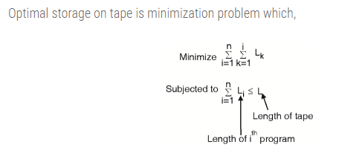
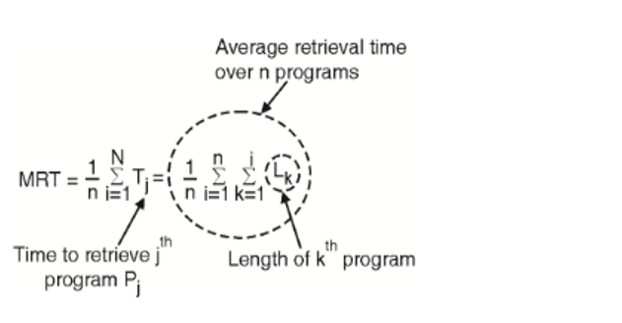
Optimal Storage Allocation on Magnetic Tapes
Mean retrieval time of n programs is the average time required to retrieve any program.
It is required to store programs in an order such that their Mean Retrieval Time is minimum. MRT is computed as,

Slide 95
Optimal Storage Allocation on Magnetic Tapes
In this case, we have to find the permutation of the program order which minimizes the MRT after storing all programs on single tape only.
There are many permutations of programs. Each gives a different MRT. Consider three programs (P1, P2, P3) with a length of (L1, L2, L3) = (5, 10, 2).
Let's find the MRT for different permutations. 6 permutations are possible for 3 items.
The Mean Retrieval Time for each permutation is listed in the following table.

Slide 96
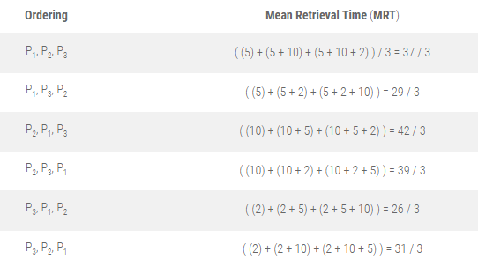
Optimal Storage Allocation on Magnetic Tapes

Slide 97
Optimal Storage Allocation on Magnetic Tapes
It should be observed from the above table that the MRT is 26/3, which is achieved by storing the programs in ascending order of their length.
Thus, greedy algorithm stores the programs on tape in non-decreasing order of their length, which ensures the minimum MRT.

Slide 98
Algorithm MRT_SINGLE_TAPE(L):
// Description: Find storage order of n programs such that mean retrieval time is minimum
// Input: L is an array of program lengths sorted in ascending order
// Output: Minimum Mean Retrieval Time
T_{j} ← 0 // Initialize total retrieval time
for i ← 1 to n do
for j ← 1 to i do
T_{j} ← T_{j} + L[j] // Accumulate retrieval time for each program
end for
end for
MRT ← T_{j} / n // Calculate mean retrieval time
return MRT

Slide 99
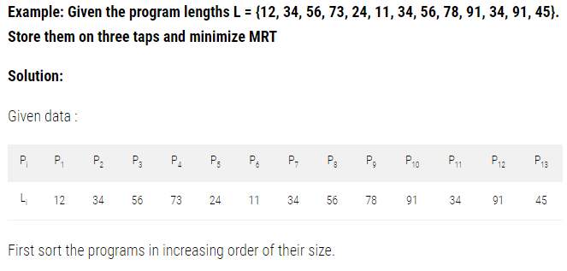

Slide 100
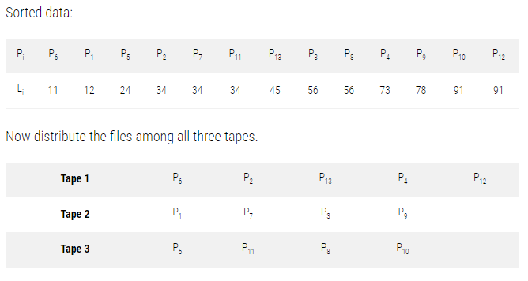

Slide 101
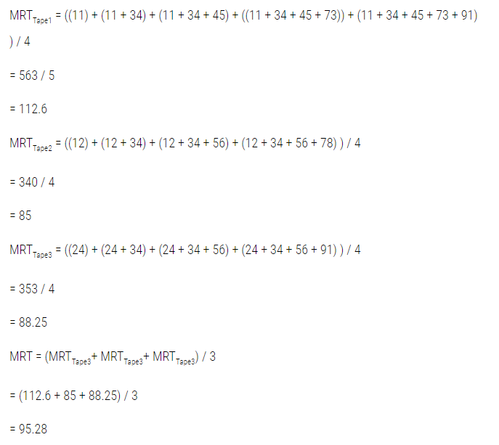

Slide 102
Minimum Cost Spanning Tree
A minimum spanning tree (MST) is a tree that spans all the vertices in a connected, undirected graph while minimizing the sum of the weights (costs) of the edges.
In simpler terms, it is a subset of the edges of the graph that forms a tree and connects all the vertices with the minimum possible total edge weight.
A single graph can have multiple spanning trees.
A Minimum Spanning Tree(MST) or minimum weight spanning tree for a weighted, connected, undirected graph is a spanning tree having a weight less than or equal to the weight of every other possible spanning tree.
The weight of a spanning tree is the sum of weights given to each edge of the spanning tree.

Slide 103
Minimum Cost Spanning Tree
Key characteristics of a minimum spanning tree:
Spanning Tree: It covers all the vertices of the graph without forming any cycles.
Acyclic: It does not contain any cycles since it is a tree.
Connected: It connects all the vertices of the original graph.
Minimum Weight: The sum of the edge weights in the spanning tree is minimized.

Slide 104
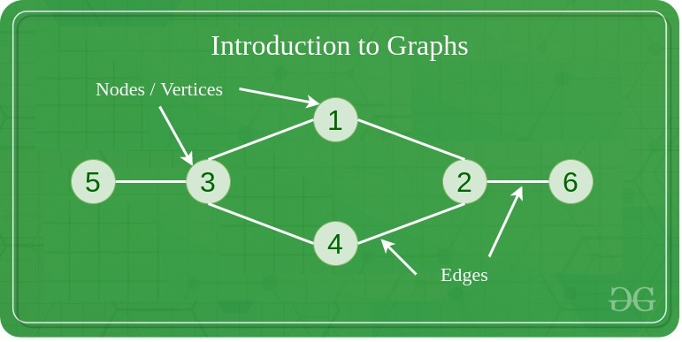
Minimum Cost Spanning Tree
A Graph is a non-linear data structure consisting of vertices and edges. More formally a Graph is composed of a set of vertices( V ) and a set of edges( E ). The graph is denoted by G(E, V).

Slide 105
Minimum Cost Spanning Tree
Vertices: Vertices are the fundamental units of the graph. Sometimes, vertices are also known as vertex or nodes. Every node/vertex can be labeled or unlabeled.
Edges: Edges are drawn or used to connect two nodes of the graph. It can be ordered pair of nodes in a directed graph. Edges can connect any two nodes in any possible way. There are no rules. Sometimes, edges are also known as arcs. Every edge can be labeled/unlabeled.
Graphs are used to solve many real-life problems. Graphs are used to represent networks. The networks may include paths in a city or telephone network or circuit network.
If G(V, E) is a graph then every spanning tree of graph G consists of (V – 1) edges, where V is the number of vertices in the graph and E is the number of edges in the graph.

Slide 106
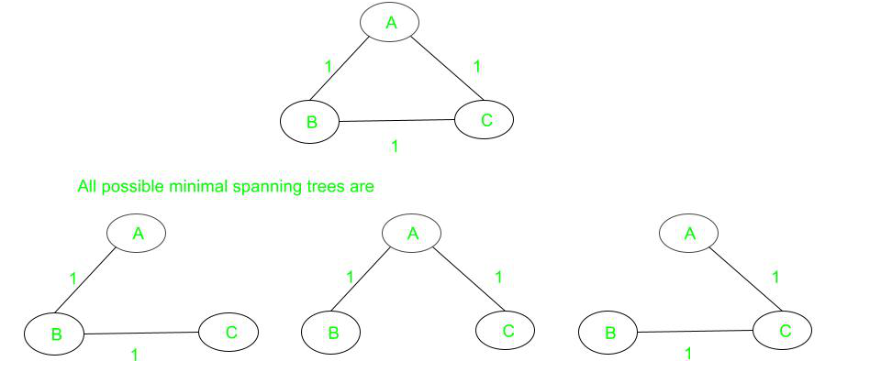
Minimum Cost Spanning Tree
Consider a complete graph of three vertices and all the edge weights are the same then there will be three spanning trees(which are also minimal) of the same path length are possible.

Slide 107
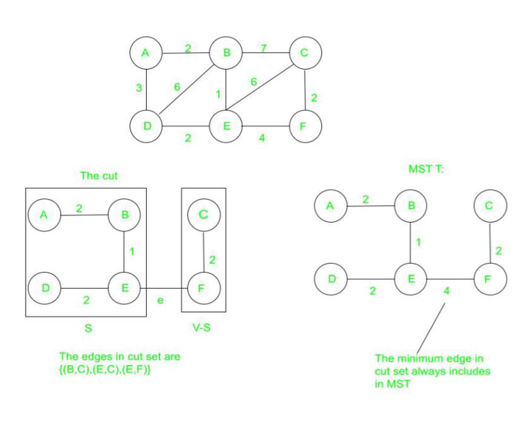
Minimum Cost Spanning Tree
For any cut C of the graph, if the weight of an edge E in the cut-set of C is strictly smaller than the weights of all other edges of the cut-set of C, then this edge belongs to all the MSTs of the graph.

Slide 108
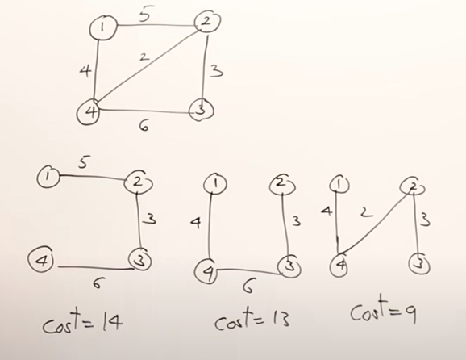
Minimum Cost Spanning Tree
Consider Example with possible spanning tree

Slide 109
Minimum Cost Spanning Tree
Algorithms for finding Minimum Spanning Tree(MST):-
Prim’s Algorithm
Kruskal’s Algorithm

Slide 110
Prim’s Algorithm
It starts with an empty spanning tree. The idea is to maintain two sets of vertices.
The first set contains the vertices already included in the MST, the other set contains the vertices not yet included.
At every step, it considers all the edges that connect the two sets and picks the minimum weight edge from these edges.
After picking the edge, it moves the other endpoint of the edge to the set containing MST.
A group of edges that connects two sets of vertices in a graph is called cut in graph theory.
So, at every step of Prim’s algorithm, find a cut (of two sets, one contains the vertices already included in MST and the other contains the rest of the vertices), pick the minimum weight edge from the cut, and include this vertex to MST Set (the set that contains already included vertices).

Slide 111
Prim’s Algorithm
Prim's Algorithm(Graph G):
1. Initialize an empty priority queue Q.
2. Add an arbitrary starting vertex to the priority queue.
3. While Q is not empty:
a. Extract the edge with the smallest weight from Q.
b. If adding this edge doesn't form a cycle, add it to the minimum spanning tree.
c. Add the vertex at the other end of the chosen edge to the priority queue if not already present.
4. Return the minimum spanning tree.

Slide 112
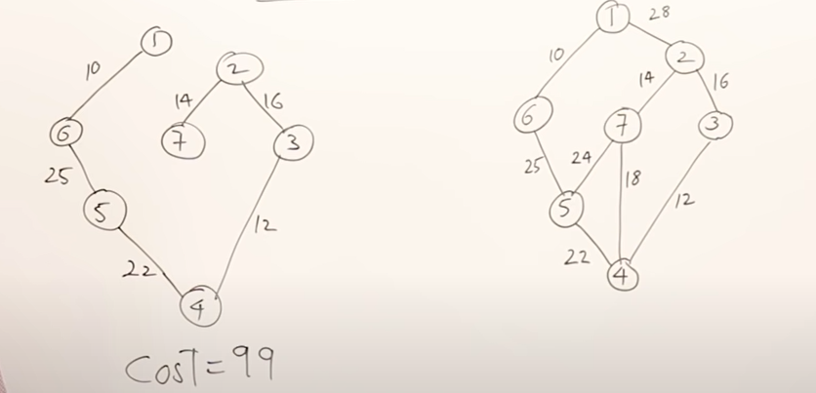
Prim’s Algorithm

Slide 113
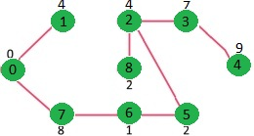
Prim’s Algorithm

Slide 114
Kruskal’s Algorithm
Kruskal's Algorithm(Graph G):
1. Sort all edges in non-decreasing order of their weights.
2. Initialize an empty minimum spanning tree.
3. Initialize a data structure to keep track of connected components.
4. For each edge in the sorted order:
a. If adding the edge does not create a cycle, add it to the minimum spanning tree and merge the connected components.
5. Return the minimum spanning tree.

Slide 115
Kruskal’s Algorithm

Slide 116
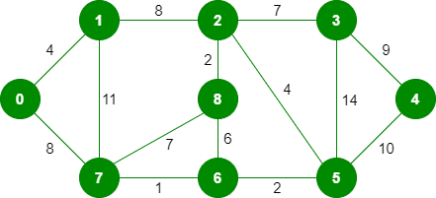
Kruskal’s Algorithm

Slide 117
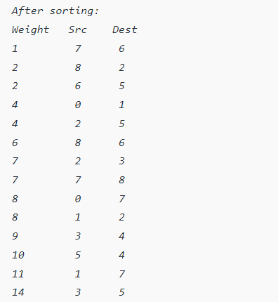

Slide 118
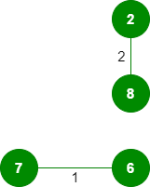

Kruskal’s Algorithm
Now pick all edges one by one from the sorted list of edges Step 1: Pick edge 7-6: No cycle is formed, include it.
Step 2: Pick edge 8-2: No cycle is formed, include it.
Step 3: Pick edge 6-5: No cycle is formed, include it.
Step 4: Pick edge 0-1: No cycle is formed, include it.
Step 5: Pick edge 2-5: No cycle is formed, include it.
Step 6: Pick edge 8-6: Since including this edge results in the cycle, discard
Step 7: Pick edge 2-3: No cycle is formed, include it.

Slide 119
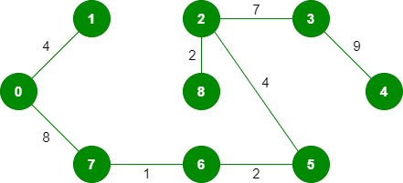
Kruskal’s Algorithm
Step 8: Pick edge 7-8: Since including this edge results in the cycle, discard.
Step 9: Pick edge 0-7: No cycle is formed, include it.
Step 10: Pick edge 1-2: Since including this edge results in the cycle, discard it.
Step 11: Pick edge 3-4: No cycle is formed, include it.
Note: Since the number of edges included in the MST equals to (V – 1), so the algorithm stops here.

Slide 120
Characteristic | Prim's Algorithm | Kruskal's Algorithm
Greedy Strategy | Prim's algorithm is Vertex-centric | Kruskal's algorithm is Edge-centric
Data Structures | Priority queue (or min-heap) | Disjoint set data structure (union-find)
Edge/Vertex Selection | Selects edge with minimum weight connecting a vertex in the current tree to a vertex outside the tree | Selects edge with minimum weight from the sorted list of edges without a predetermined starting point
Complexity | O(E log V), where E is the number of edges, V is the number of vertices | O(E log E), where E is the number of edges
Starting Point | Starts with a single vertex and grows the tree | Starts with an empty tree and adds edges
Applications | Suitable for dense graphs or graphs with dense clusters | Suitable for sparse graphs or graphs with edges of similar weights
Termination | Terminates when all vertices are included in the minimum spanning tree | Terminates when all vertices are included in the minimum spanning tree

Slide 121
Tree Vertex Splitting
Directed and weighted binary tree
Consider a network of power line transmission
The transmission of power from one node to the other results in some loss, such as drop in voltage
Each edge is labeled with the loss that occurs (edge weight)
Network may not be able to tolerate losses beyond a certain level
You can place boosters in the nodes to account for the losses
Definition 1 Given a network and a loss tolerance level, the tree vertex splitting problem is to determine the optimal placement of boosters.
You can place boosters only in the vertices and nowhere else

Slide 122
Tree Vertex Splitting
The tree vertex splitting problem involves optimizing the placement of boosters in a directed and weighted binary tree, representing a power transmission network.
The objective is to minimize losses, which are associated with the edges (transmission lines) in the tree.
Network Description:
The network is represented as a directed and weighted binary tree.
Nodes in the tree correspond to locations in the power transmission network.
Edges in the tree are labeled with weights that represent the losses occurring during the transmission between nodes.
Loss Tolerance Level:
There is a specified loss tolerance level that the network can withstand.
The total loss along a path from the source to any node should not exceed this tolerance level.

Slide 123
Tree Vertex Splitting
Objective:
The goal is to determine the optimal placement of boosters in the vertices (nodes) of the tree.
Boosters are placed to compensate for losses and ensure that the total loss along any path does not exceed the given tolerance level.
Constraints:
Boosters can only be placed in the vertices of the tree, and not along the edges.
Optimization:
The optimization problem involves finding the best locations for boosters to minimize losses in the network.

Slide 124

Tree Vertex Splitting
Let T = (V, E, w) be a weighted directed tree
V is the set of vertices
E is the set of edges
w is the weight function for the edges
w_{ij} is the weight of the edge hi, ji ∈ E
We say that w_{ij} = ∞ if <i, j> !∈ E
A vertex with in-degree zero is called a source vertex
A vertex with out-degree zero is called a sink vertex
For any path P ∈ T, its delay d(P) is defined to be the sum of the weights (w_{ij} ) of that path, or

Slide 125
Tree Vertex Splitting
Delay of the tree T, d(T) is the maximum of all path delays.
Split node is the booster station
Tree vertex splitting problem is to identify a set X ⊆ V of minimum cardinality (minimum number of booster stations) for which d(T /X) ≤ δ for some specified tolerance limit δ
TVSP has a solution only if the maximum edge weight is ≤ δ

Slide 126

Greedy solution for TVSP
We want to minimize the number of booster stations (X)
For each node u ∈ V , compute the maximum delay d(u) from u to any other node in its subtree
If u has a parent v such that d(u) + w(v, u) > δ, split u and set d(u) to zero
Computation proceeds from leaves to root
Delay for each leaf node is zero
The delay for each node v is computed from the delay for the set of its children C(v)

Slide 127
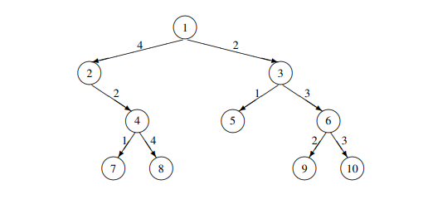
Solve tree for δ = 5

Slide 128
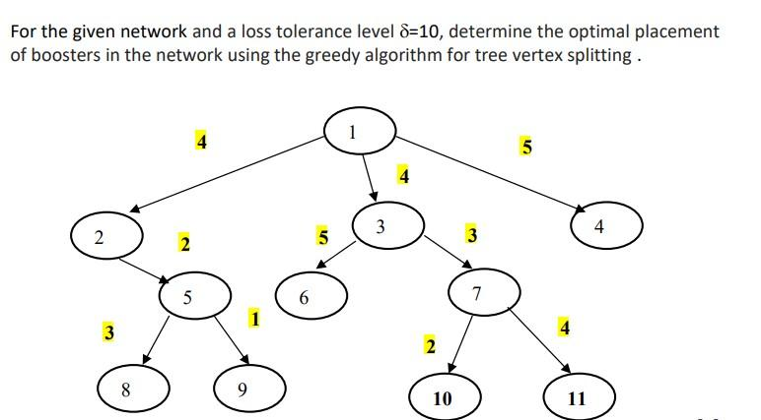

Slide 129

Thank You

